Slide 2
Absence of Copyright
This slideshow contains photos, diagrams, and information, some of which were attained through internet searches of public websites. The author of this presentation does not own the copyright on this information, so this slideshow is for personal use only—not for sale or profit. Please utilize it to seek the Lord and grow in your knowledge of His Word and ways.
Bro Stan’s Revelation Study is available on our church website:
www.faithprinceton.org

Slide 4
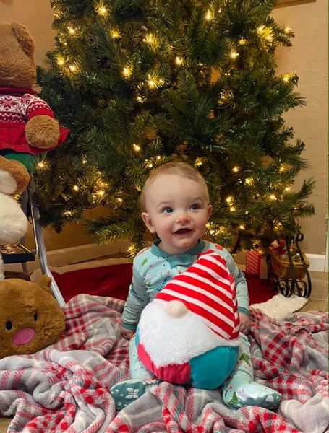
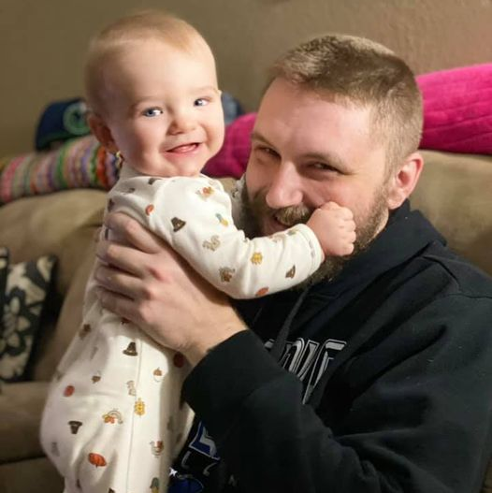
Noah’s First
Christmas
Daddy’s little dude

Slide 5
Prayer and Announcements
Sundays Facebook Live or In-person:
9:15 Small Group Sunday School Classes
10:30 Worship
--------------------------------
Mask in and Mask out...

Slide 8
BEGIN HERE December 9, 2020
Week 27 – Revelation 20
The Millenial Reign

Slide 9
Revelation 19:19 Assembling for War
19 And I saw the beast and the kings of the earth and their armies, assembled to make war against Him who sat on the horse, and against His army.
Notes:
LAST WEEK
Revelation 19:11-14
11 And I saw heaven opened, and behold, a white horse, and He who sat on it is called Faithful and True, and in righteousness He judges and wages war. 12 His eyes are a flame of fire, and on His head are many crowns; and He has a name written on Him which no one knows except Himself. 13 He is clothed with a robe dipped in blood, and His name is called The Word of God. 14 And the armies which are in heaven, clothed in fine linen, white and clean, were following Him on white horses.
15 From His mouth comes a sharp sword, so that with it He may strike down the nations, and He will rule them with a rod of iron; and He treads the wine press of the fierce wrath of God, the Almighty. 16 And on His robe and on His thigh He has a name written: “KING OF KINGS, AND LORD OF LORDS.”
17-18 Feast of the Birds on flesh

Slide 10
Revelation 20:1-3 The Dragon Locked Up
1 Then I saw an angel coming down from heaven, holding the key of the abyss and a great chain in his hand. 2 And he took hold of the dragon, the serpent of old, who is the devil and Satan, and bound him for a thousand years; 3 and he threw him into the abyss and shut it and sealed it over him, so that he would not deceive the nations any longer, until the thousand years were completed; after these things he must be released for a short time.
Notes:
Another mighty angel!!!
Holds key of the abyss = symbol of authority and control
And a great chain = symbol of punishment and control
Bound him for a thousand years = hindered and prevented from doing his evil
ALL FOUR NAMES FOR
DRAGON, SERPENT OF OLD, DEVIL, SATAN
Revelation 12:9 And the great dragon was hurled down--that ancient serpent called the devil and Satan, the deceiver of the whole world. He was hurled to the earth, and his angels with him.
Rev 12 hurled down... Rev 20 NOW LOCKED UP !
SO THAT (GREEK:
He would not deceive the nations any longer, until the 1000 years were completed
Then released for a short time
Luke 8:31
And the demons kept begging Jesus not to order them to go into the Abyss.
2 Peter 2:4
For if God did not spare the angels when they sinned, but cast them deep into hell, placing them in chains of darkness to be held for judgment;
Jude 1:6
And the angels which kept not their first estate, but left their own habitation, he hath reserved in everlasting chains under darkness unto the judgment of the great day.

Slide 11
MILLENIAL VIEWS OF REVELATION
MILLENIAL REIGN = 1,000 YEARS
AMILLENIALISM
POSTMILLENIALISM
PREMILLENIALISM
(Historical or Dispensational)
[Pre-trib, Mid-trib, Post-trib]
Notes:
READ VERSES 4-10
https://www.blueletterbible.org/faq/mill.cfm
Why Is This Millennium in Question?
Some see this as a future earthly theocracy by which Christ will rule over the nations for a thousand years. Others see it as a time during which Christ will rule earth from heaven through the life-changing power of the Gospel. Still others look at it in another way. And the multitude of others holds a multitude of other interpretations.
One's final interpretation of the thousand years from Revelation 20 depends more upon certain factors related to a Christian's hermeneutic than the strict text of the ten much debated verses. There are several ways in which orthodox Christians choose to come to Scripture and depending on which of these methods is used, one's understanding of eschatological issues — and a host of others as well — will experience changes both significant and trivial. And since one interprets Scripture primarily through the filter of his understanding of other passages in the Word, one's millennial view does have an effect (whether great or small) on the way in which he lives his life.

Slide 12
DISCUSSION OF THE THREE (FOUR) VIEWS:
https://www.blueletterbible.org/faq/mill.cfm
https://www.thegospelcoalition.org/essay/views-of-the-millennium/
Alan S. Bandy
https://rediscoveringthebible.com/MillennialViews.html
Kenneth J. Morgan
Notes:
GREAT DISCUSSION OF THE THREE (FOUR) VIEWS: https://www.blueletterbible.org/faq/mill.cfm
Conclusion
So what should be concluded from all of this? Before coming to a dogmatic millennial perspective, the lone fact that so many well-intentioned and intelligent Christians believe so variously when it comes to Revelation 20:1-15 must give us pause. The Book of Revelation itself is probably the most curious and oft-debated piece of the canon. This ought to place us in a position of caution when either accepting or dismissing another's interpretation.
https://www.thegospelcoalition.org/essay/views-of-the-millennium/
Alan S. Bandy...
When studying Revelation and eschatology it is all too easy to lose sight of the call of Christ in Revelation, which is to live victoriously as overcomers of sin, the world, and the devil and to remain faithful to him at all costs because he will make all things right in the end. Whatever view one thinks best reflects the teaching of Scripture, it must always be kept in mind that Scripture always presents the doctrine of last things as a motivation for faithful living. In the end, perhaps John Frame draws our attention to the most important eschatological point: “So far as I can see, every Bible passage about the return of Christ is written for a practical purpose –not to help us develop a theory of history, but to motivate our obedience.”
https://rediscoveringthebible.com/MillennialViews.html

Slide 13
Revelation 20:1-10 The Millenial Reign
4 Then I saw thrones, and they sat on them, and judgment was given to them. And I saw the souls of those who had been beheaded because of their testimony of Jesus and because of the word of God, and those who had not worshiped the beast or his image, and had not received the mark on their foreheads and on their hands; and they came to life and reigned with Christ for a thousand years.

Slide 14
Revelation 20:1-10 The Millenial Reign
5 The rest of the dead did not come to life until the thousand years were completed. This is the first resurrection. 6 Blessed and holy is the one who has a part in the first resurrection; over these the second death has no power, but they will be priests of God and of Christ, and will reign with Him for a thousand years.

Slide 15
Revelation 20:1-10 The Millenial Reign
7 When the thousand years are completed, Satan will be released from his prison, 8 and will come out to deceive the nations which are at the four corners of the earth, Gog and Magog, to gather them together for the war; the number of them is like the sand of the seashore. 9 And they came up on the broad plain of the earth and surrounded the camp of the saints and the beloved city, and fire came down from heaven and devoured them.

Slide 16
Revelation 20:1-10 The Millenial Reign
10 And the devil who deceived them was thrown into the lake of fire and brimstone, where the beast and the false prophet are also; and they will be tormented day and night forever and ever.

Slide 17
MILLENIAL VIEWS OF REVELATION
MILLENIAL REIGN = 1,000 YEARS
AMILLENIALISM
POSTMILLENIALISM
PREMILLENIALISM
(Historical or Dispensational)
[Pre-trib, Mid-trib, Post-trib]
Notes:
READ VERSES 4-10
https://www.blueletterbible.org/faq/mill.cfm
Why Is This Millennium in Question?
Some see this as a future earthly theocracy by which Christ will rule over the nations for a thousand years. Others see it as a time during which Christ will rule earth from heaven through the life-changing power of the Gospel. Still others look at it in another way. And the multitude of others holds a multitude of other interpretations.
One's final interpretation of the thousand years from Revelation 20 depends more upon certain factors related to a Christian's hermeneutic than the strict text of the ten much debated verses. There are several ways in which orthodox Christians choose to come to Scripture and depending on which of these methods is used, one's understanding of eschatological issues — and a host of others as well — will experience changes both significant and trivial. And since one interprets Scripture primarily through the filter of his understanding of other passages in the Word, one's millennial view does have an effect (whether great or small) on the way in which he lives his life.

Slide 18
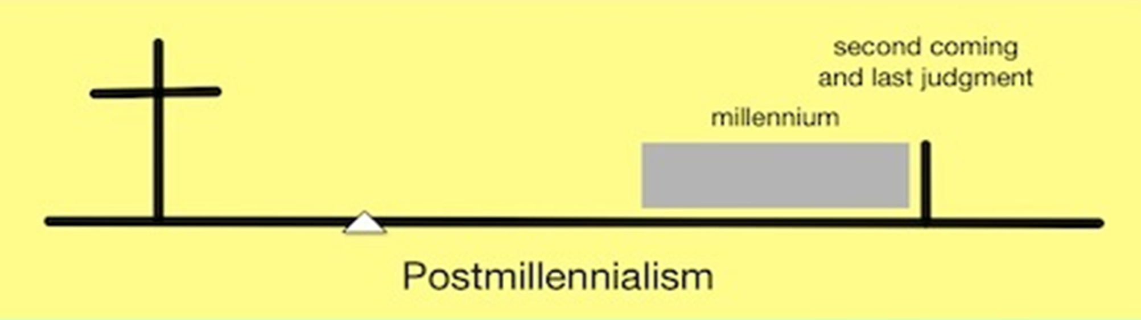

Slide 20
Revelation 20:1-10 The Millenial Reign
4 Then I saw thrones, and they sat on them, and judgment was given to them. And I saw the souls of those who had been beheaded because of their testimony of Jesus and because of the word of God, and those who had not worshiped the beast or his image, and had not received the mark on their foreheads and on their hands; and they came to life and reigned with Christ for a thousand years.
Notes:
Thrones and judgment given AND “THEY” SAT ON THEM ➔ saints? MARTYRS? (elders? Angels?)
Matthew 16 Jesus and the keys to the Kingdom
1 Corinthians 6 You will judge angels (wisdom to make judgments in the church)
And I saw the souls of those who had been beheaded
because of their testimony of Jesus and
because of the word of God, and
those who had not worshiped the beast or his image, and
had not received the mark on their foreheads and on their hands;
and they came to life and reigned with Christ for a thousand years. ➔ RESURRECTION REIGN
Doesn’t seem to fit in the Amillenial or Post-millennial views???

Slide 21
Revelation 20:1-10 The Millenial Reign
5 The rest of the dead did not come to life until the thousand years were completed. This is the first resurrection. 6 Blessed and holy is the one who has a part in the first resurrection; over these the second death has no power, but they will be priests of God and of Christ, and will reign with Him for a thousand years.
Notes:
6 Blessed and holy is the one who has a part in the first resurrection;
over these the second death has no power, (judgment and hell?)
but they will be priests of God and of Christ,
and will reign with Him for a thousand years.
Priests and Rulers???
Like the elders of Israel?

Slide 22
Revelation 20:1-10 The Millenial Reign
7 When the thousand years are completed, Satan will be released from his prison, 8 and will come out to deceive the nations which are at the four corners of the earth, Gog and Magog, to gather them together for the war; the number of them is like the sand of the seashore. 9 And they came up on the broad plain of the earth and surrounded the camp of the saints and the beloved city, and fire came down from heaven and devoured them.
Notes:
Satan released
Deceive the nations (4 corners, Gog and Magog)
Gather together for war
Number like sand on seashore
AFTER CHRIST HAS RULED FOR 1,000 YEARS OF PEACE AND ABSENCE OF SATAN’S EVIL INFLUENCE, MAN IS STILL HORRIBLY WICKED AND DRAWN TO HIS DECEPTION
Desperately wicked!!!
BROAD PLAIN = Jesus: Wide is the path to destruction and broad is the way...
Surrounded the camp of the saints and beloved city BUT...
FIRE CAME DOWN FROM HEAVEN AND DEVOURED THEM !
We still are not fighting the battles.
Heaven fights on behalf of the saints!!!!

Slide 23
Revelation 20:1-10 The Millenial Reign
10 And the devil who deceived them was thrown into the lake of fire and brimstone, where the beast and the false prophet are also; and they will be tormented day and night forever and ever.
Notes:
10 And the devil who deceived them was thrown into the lake of fire and brimstone, where the beast and the false prophet are also; and they will be tormented day and night forever and ever.
Hell fire and brimstone!!!!
Where beast and false prophet ARE ➔ a place of current existence
Tormented day and night forever! ➔ a place of punishment and pain
DON’T GO THERE !
Matthew 25:41 Separation of Sheep and Goats
41 “Then he will say to those on his left, ‘Depart from me, you who are cursed, into the eternal fire prepared for the devil and his angels. 42 For I was hungry and you gave me nothing to eat, I was thirsty and you gave me nothing to drink, 43 I was a stranger and you did not invite me in, I needed clothes and you did not clothe me, I was sick and in prison and you did not look after me.’
44 “They also will answer, ‘Lord, when did we see you hungry or thirsty or a stranger or needing clothes or sick or in prison, and did not help you?’
45 “He will reply, ‘Truly I tell you, whatever you did not do for one of the least of these, you did not do for me.’
46 “Then they will go away to eternal punishment, but the righteous to eternal life.”

Slide 24
Revelation 20:11-15 The Great White Throne Judgment
11 Then I saw a great white throne and Him who sat upon it, from whose presence earth and heaven fled, and no place was found for them. 12 And I saw the dead, the great and the small, standing before the throne, and books were opened; and another book was opened, which is the book of life; and the dead were judged from the things which were written in the books, according to their deeds.
Notes:
Vs 11 earth and heaven fled
2 Peter 3
New International Version
The Day of the Lord
1 Dear friends, this is now my second letter to you. I have written both of them as reminders to stimulate you to wholesome thinking. ² I want you to recall the words spoken in the past by the holy prophets and the command given by our Lord and Savior through your apostles.
³ Above all, you must understand that in the last days scoffers will come, scoffing and following their own evil desires. ⁴ They will say, “Where is this ‘coming’ he promised? Ever since our ancestors died, everything goes on as it has since the beginning of creation.” ⁵ But they deliberately forget that long ago by God’s word the heavens came into being and the earth was formed out of water and by water. ⁶ By these waters also the world of that time was deluged and destroyed. ⁷ By the same word the present heavens and earth are reserved for fire, being kept for the day of judgment and destruction of the ungodly.
⁸ But do not forget this one thing, dear friends: With the Lord a day is like a thousand years, and a thousand years are like a day. ⁹ The Lord is not slow in keeping his promise, as some understand slowness. Instead he is patient with you, not wanting anyone to perish, but everyone to come to repentance.
¹⁰ But the day of the Lord will come like a thief. The heavens will disappear with a roar; the elements will be destroyed by fire, and the earth and everything done in it will be laid bare.
¹¹ Since everything will be destroyed in this way, what kind of people ought you to be? You ought to live holy and godly lives ¹² as you look forward to the day of God and speed its coming. That day will bring about the destruction of the heavens by fire, and the elements will melt in the heat. ¹³ But in keeping with his promise we are looking forward to a new heaven and a new earth, where righteousness dwells.
¹⁴ So then, dear friends, since you are looking forward to this, make every effort to be found spotless, blameless and at peace with him. ¹⁵ Bear in mind that our Lord’s patience means salvation, just as our dear brother Paul also wrote you with the wisdom that God gave him. ¹⁶ He writes the same way in all his letters, speaking in them of these matters. His letters contain some things that are hard to understand, which ignorant and unstable people distort, as they do the other Scriptures, to their own destruction.
¹⁷ Therefore, dear friends, since you have been forewarned, be on your guard so that you may not be carried away by the error of the lawless and fall from your secure position. ¹⁸ But grow in the grace and knowledge of our Lord and Savior Jesus Christ. To him be glory both now and forever! Amen.

Slide 25
Revelation 20:11-15 The Great White Throne Judgment
11 Then I saw a great white throne and Him who sat upon it, from whose presence earth and heaven fled, and no place was found for them. 12 And I saw the dead, the great and the small, standing before the throne, and books were opened; and another book was opened, which is the book of life; and the dead were judged from the things which were written in the books, according to their deeds.
Notes:
Great White Throne Judgment
All people?
Book of Life trumps what is written in the books of deeds
Just the unbelievers?
??? Separate BEMA SEAT ?? (Christians have a judgment of works at the judgment seat [bema] of Christ 2 Corinthians 5:10: For we must all appear before the judgment seat of Christ, so that each one may receive what is due for what he has done in the body, whether good or evil.)
https://www.gotquestions.org/great-white-throne-judgment.html
Some Christians believe that the Scriptures reveal three different judgments to come. The first is the judgment of the sheep and the goats or a judgment of the nations (Matthew 25:31-36). This takes place after the tribulation period but prior to the millennium; its purpose is to determine who will enter the millennial kingdom. The second is a judgment of believers’ works, often referred to as the “judgment seat [bema] of Christ” (2 Corinthians 5:10). At this judgment, Christians will receive degrees of reward for their works or service to God. The third is the great white throne judgment at the end of the millennium (Revelation 20:11-15). This is the judgment of unbelievers in which they are judged according to their works and sentenced to everlasting punishment in the lake of fire. Other Christians believe that all three of these judgments speak of the same final judgment, not of three separate judgments. In other words, the great white throne judgment in Revelation 20:11-15 will be the time that believers and unbelievers alike are judged. Those whose names are found in the book of life will be judged for their deeds in order to determine the rewards they will receive or lose. Those whose names are not in the book of life will be judged according to their deeds to determine the degree of punishment they will receive in the lake of fire. Those who hold this view believe that Matthew 25:31-46 is another description of what takes place at the great white throne judgment. They point to the fact that the result of this judgment is the same as what is seen after the great white throne judgment in Revelation 20:11-15. The sheep (believers) enter into eternal life, while the goats (unbelievers) are cast into “eternal punishment” (Matthew 25:46). Whichever view one holds of the great white throne judgment, it is important to never lose sight of the facts concerning the coming judgment(s). First, Jesus Christ will be the judge, all unbelievers will be judged by Christ, and they will be punished according to the works they have done. The Bible is very clear that unbelievers are storing up wrath against themselves (Romans 2:5) and that God will “give to each person according to what he has done” (Romans 2:6). Believers will also be judged by Christ, but since Christ’s righteousness has been imputed to us and our names are written in the book of life, we will be rewarded, but not punished, according to our deeds. Romans 14:10-12 says that we will all stand before the judgment seat of Christ and that each one of us will give an account to God.

Slide 26
Revelation 20:11-15 The Great White Throne Judgment
13 And the sea gave up the dead who were in it, and Death and Hades gave up the dead who were in them; and they were judged, each one of them according to their deeds. 14 Then Death and Hades were thrown into the lake of fire. This is the second death, the lake of fire. 15 And if anyone’s name was not found written in the book of life, he was thrown into the lake of fire.
Notes:
God will cast Satan, the deceiver, into "the lake of fire" that He previously prepared for the devil and his angels (Matt. 25:41).
Death and Hades ➔ final enemies of mankind (1 Corinthians 15 “death is swallowed up in victory!”)
NO MORE DEATH !!!!
ETERNAL LIFE !!!
But only for those whose names are found written in the book of life ! (Lamb’s Book of Life, OT: book of the living)

Slide 27
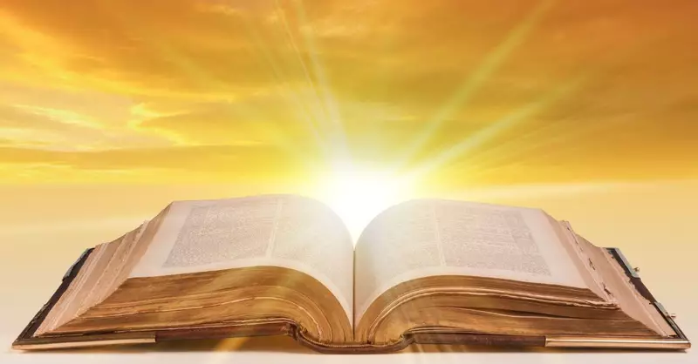
Is your name written in the Lamb’s Book of Life?
Notes:
The Lamb’s Book of Life
Luke 10:20 ESV
Nevertheless, do not rejoice in this, that the spirits are subject to you, but rejoice that your names are written in heaven.”
Revelation 13:8 ESV
And all who dwell on earth will worship it, everyone whose name has not been written before the foundation of the world in the book of life of the Lamb who was slain.
Revelation 21:27 ESV
But nothing unclean will ever enter it, nor anyone who does what is detestable or false, but only those who are written in the Lamb's book of life.
IS YOUR NAME WRITTEN IN THE LAMB’S BOOK OF LIFE: CALL OUT TO JESUS NOW... ASK HIS FORGIVENESS AND CLEANSING... ACCEPT HIS LORDSHIP AND MERCY... BE SET FREE FROM YOUR SLAVERY TO SATAN, SELF, AND SIN... YIELD YOUR HEART TO THE FATHER...

